Slide 1
Lab Exercise: 6
Developing Alpha-Beta pruning using Min-Max Algorithm

Slide 2
Min-Max Algorithm
Minimax is a kind of backtracking algorithm that is used in decision making and game theory to find the optimal move for a player, assuming that your opponent also plays optimally. It is widely used in two player turn-based games such as Tic-Tac-Toe, Backgammon, Mancala, Chess, etc.
In Minimax the two players are called maximizer and minimizer. The maximizer tries to get the highest score possible while the minimizer tries to do the opposite and get the lowest score possible.

Slide 3
Min-Max Algorithm
Let's define steps of the algorithm in general:
Construct the complete game tree
Evaluate scores for leaves using the evaluation function
Back-up scores from leaves to root, considering the player type:
For max player, select the child with the maximum score
For min player, select the child with the minimum score
At the root node, choose the node with max value and perform the corresponding move

Slide 4
Alpha-Beta Pruning
Alpha-Beta pruning is not actually a new algorithm, rather an optimization technique for minimax algorithm.
It reduces the computation time by a huge factor.
This allows us to search much faster and even go into deeper levels in the game tree.
It cuts off branches in the game tree which need not be searched because there already exists a better move available.
It is called Alpha-Beta pruning because it passes 2 extra parameters in the minimax function, namely alpha and beta.

Slide 5
Algorithm
Start DFS traversal from the root of game tree
Set initial values of alpha and beta as follows:
a. alpha = INT_MIN(-INFINITY)
b. beta = INT_MAX(+INFINITY)
Traverse tree in DFS fashion where maximizer player tries to get the highest score possible while the minimizer player tries to get the lowest score possible.
While traversing update the alpha and beta values accordingly

Slide 6
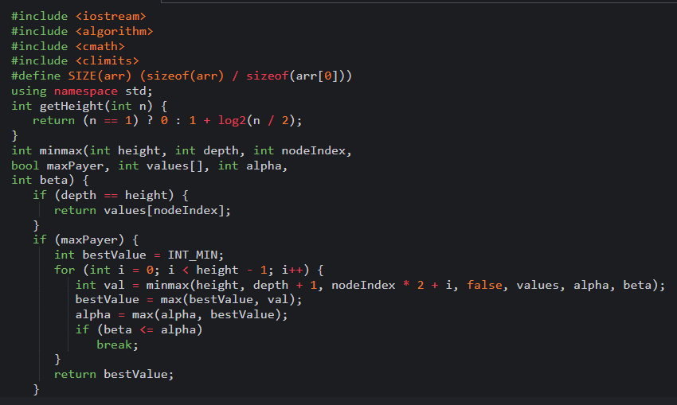
Code

Slide 7
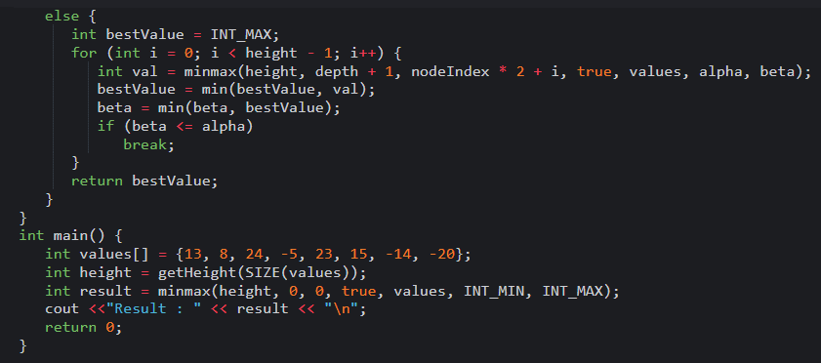
Code

Slide 8

Code
Output:

Slide 9
Thank You
VIVEK BURUGUDDA RA1911003010316
HARSHIL AGARWAL RA1911003010325
RITESH RAI RA1911003010333
PUNEET SHARMA RA1911003010331
PRAKHAR VIJAY RA1911003010337

